Slide 1
Linked List
ADDIN ADITYA, M.KOM
DEPARTMENT OF INFORMATION SYSTEM
SEKOLAH TINGGI INFORMATIKA DAN KOMPUTER INDONESIA
2018

Slide 2
Introduction
A linked list is a sequence of data structure which are connected together via links
Linked list is a sequences of links which contains items. Each links contains a connection to another link.
Linked list is the second most used data structure after array

Slide 3
Important Terms
Link → each link of a linked list can store a data called an element
Next → each link of a linked list contains a link to the next link
First List → a linked list contains the connection link to the first link

Slide 4
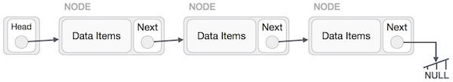
Linked Link Representation
Linked List contains a link element called first
Each link carries a data field(s) and a link field called next
Each link is linked with its next link
Last link carries a link as null to mark the end of the list

Slide 5
Types of Linked List
Simple Linked List → item navigation is forward only
Doubly Linked List → items can be navigated forward and backward
Circular Linked List → last item contains link of the first element as next and the first element has a link to the last element as previous

Slide 6
Basic Operations
Insertion: adds an element at the beginning of the list
Deletion: deletes an element at the beginning of the list
Display: display the complete list
Search: search an element using the given key
Delete: deletes an element using the given key

Slide 7
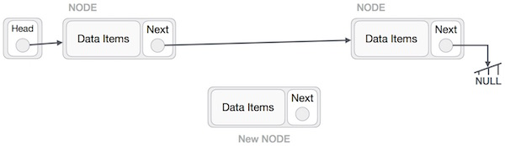
Insertion Operation
Adding a new node in a linked list is a more than one step activity. First we create a node using the same structure and find the location where it has to be inserted. Imagine that we will insert a node B (new node) between A (Left Node) and C (Right Node)

Slide 8
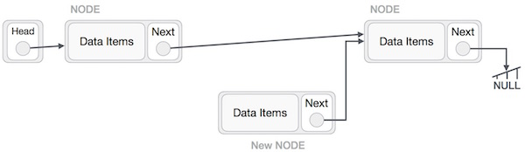
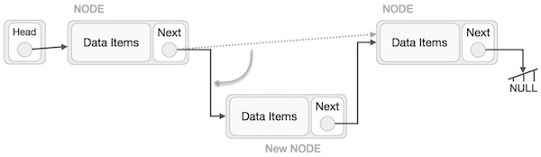
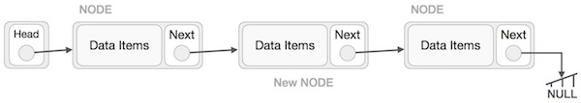
FINALLY

Slide 9
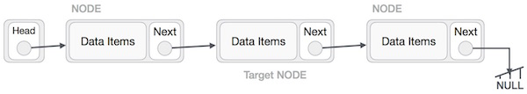
Deletion Operation
Deletion is also more than one step process. First locate the target node that need to be removed, by using searching algorithm
The left node (Previous) of the target node now should point to the next node of the target node

Slide 10
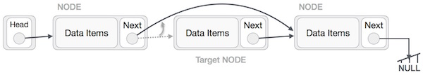
Deletion Operation (Cont’d)
This will remove the link that was pointing to the target node. Now using code TargetNode.next → null we will remove what the target node is pointing at

Slide 11
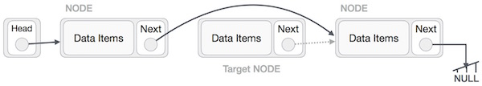
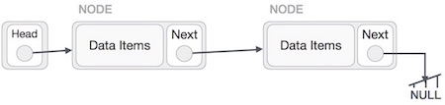
Deletion Operation (Cont’d)
If you wish to use the deleted node later, you can keep it in memory
Otherwise, just delete it permanently in memory and wipe off the target completely

Slide 12
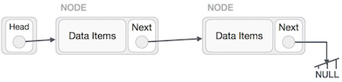
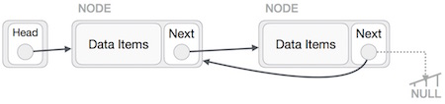
Reverse Operation
This operation is through one. We need to make the last node to be pointed by the head node and reverse the whole linked list
First we traverse to the end of the list. It should be pointing to null. Now we shall make it point to its previous node

Slide 13
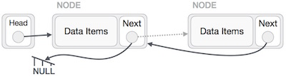
Reverse Operation (Cont’d)
We have to make sure that the last node is no more last node. So we need some temporary node, which looks like the head node pointing to the last node. Now we shall make all left side nodes point to their previous nodes one by one

Slide 14
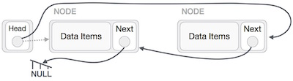

Except the first node pointed by the head node, all nodes should point to their predecessor, making them their new successor. The first node will point to NULL

Slide 15
Doubly Linked List
Doubly linked list is a variation of linked list in which navigation is possible in both ways, either forward or backward easily as compared single linked list
Link → each link of a linked list can store a data called an element
Next → each link of a linked list contains a link to the next link
Prev → each link of a linked list contains a link to the previous link

Slide 16
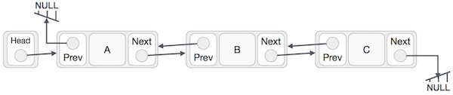
Doubly Linked List Representation

Slide 17
Basic Operations
Insertion
Deletion
Insert Last
Delete Last
Insert After
Delete
Display Forward
Display Backward

Slide 18
Insertion Operation
//insert link at the first location
void insertFirst(int key, int data) {
//create a link
struct node *link = (struct node*) malloc(sizeof(struct node));
link->key = key;
link->data = data;
if(isEmpty()) {
//make it the last link
last = link;
} else {
//update first prev link
head->prev = link;
}
//point it to old first link
link->next = head;
//point first to new first link
head = link;
}

Slide 19
Deletion Operation
//delete first item
struct node* deleteFirst() {
//save reference to first link
struct node *tempLink = head;
//if only one link
if(head->next == NULL) {
last = NULL;
} else {
head->next->prev = NULL;
}
head = head->next;
//return the deleted link
return tempLink;
}

Slide 20
Insertion at The End of Operation
//insert link at the last location
void insertLast(int key, int data) {
//create a link
struct node *link = (struct node*) malloc(sizeof(struct node));
link->key = key;
link->data = data;
if(isEmpty()) {
//make it the last link
last = link;
} else {
//make link a new last link
last->next = link;
//mark old last node as prev of new link
link->prev = last;
}
//point last to new last node
last = link;
}

Slide 21
Circular Linked List
Circular Linked List is a variation of Linked list in which the first element points to the last element and the last element points to the first element. Both Singly Linked List and Doubly Linked List can be made into a circular linked list

Slide 22

Singly Linked List
In singly linked list, the next pointer of the last node points to the first node

Slide 23

Doubly Linked List
In doubly linked list, the next pointer of the last node points to the first node and the previous pointer of the first node points to the last node making the circular in both directions

